Slide 1
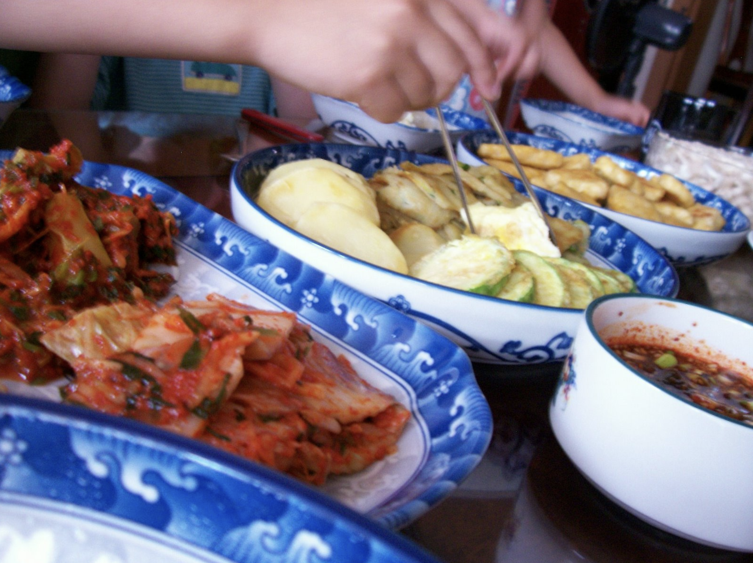
Writing 202
2-minute Instructions Project Progress Report
October 17, 2018
By Dave Howland
How to cook a simple Korean beef BBQ dinner

Slide 2
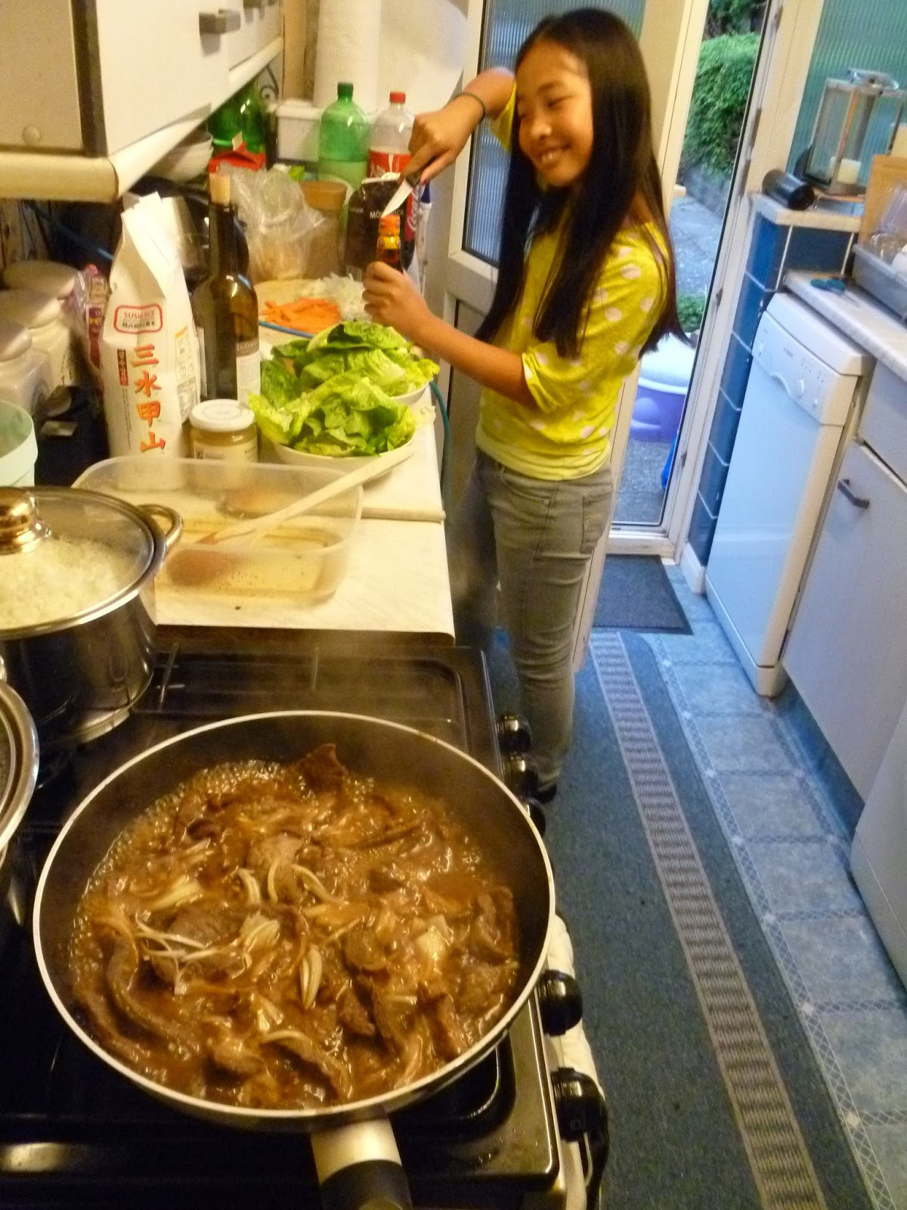
AUDIENCE & PURPOSE
SETTING & HAZARDS
PERFORMANCE OBJECTIVES
USABILITY TESTING FEEDBACK

Slide 3
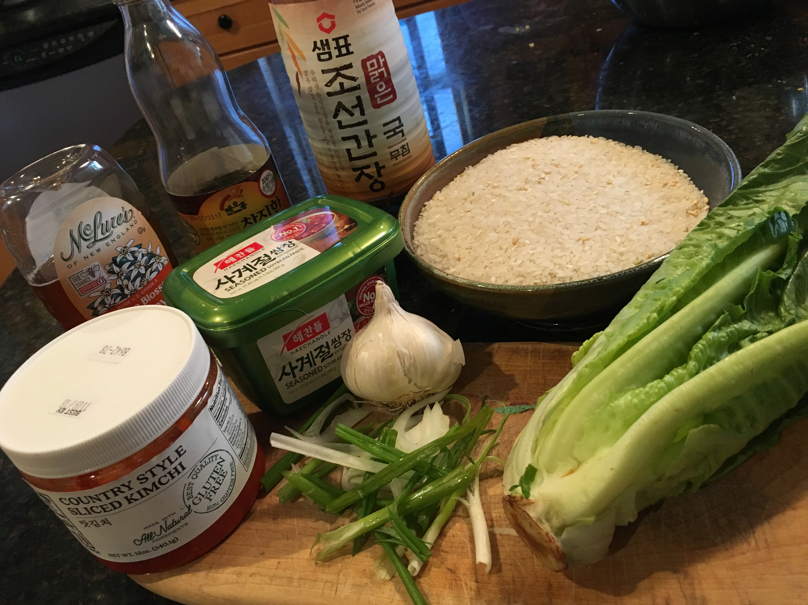
Questions?

